Slide 1
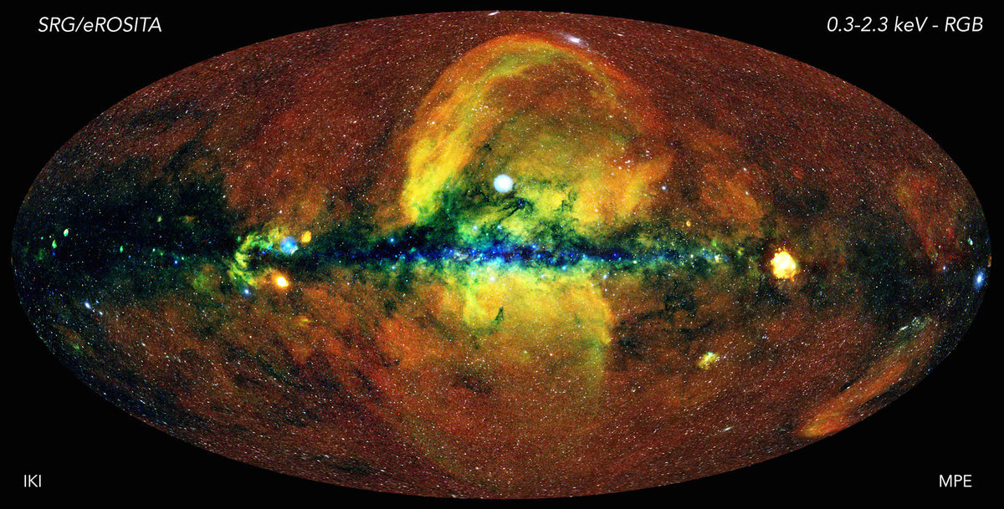
IFTA Log Normalization, Analytics and ML
Pavan R Hebbar
University of Alberta

Slide 2
IFTA and the need for ML
Standardize and simplify tax calculation and reporting
Manual auditing is tedious and prone to error - transposition mistakes, missing entries, missed state crossings, etc.
Standardization and automation reduces errors by 5-15%
Cleaner data integration

Slide 3
Challenges
Check for manual scribbles/unrelated additions on scanned documents
Account for inaccuracies in OCR extraction
Changing formats of distance logs between different fleets
Invoices not standardized across sellers

Slide 4
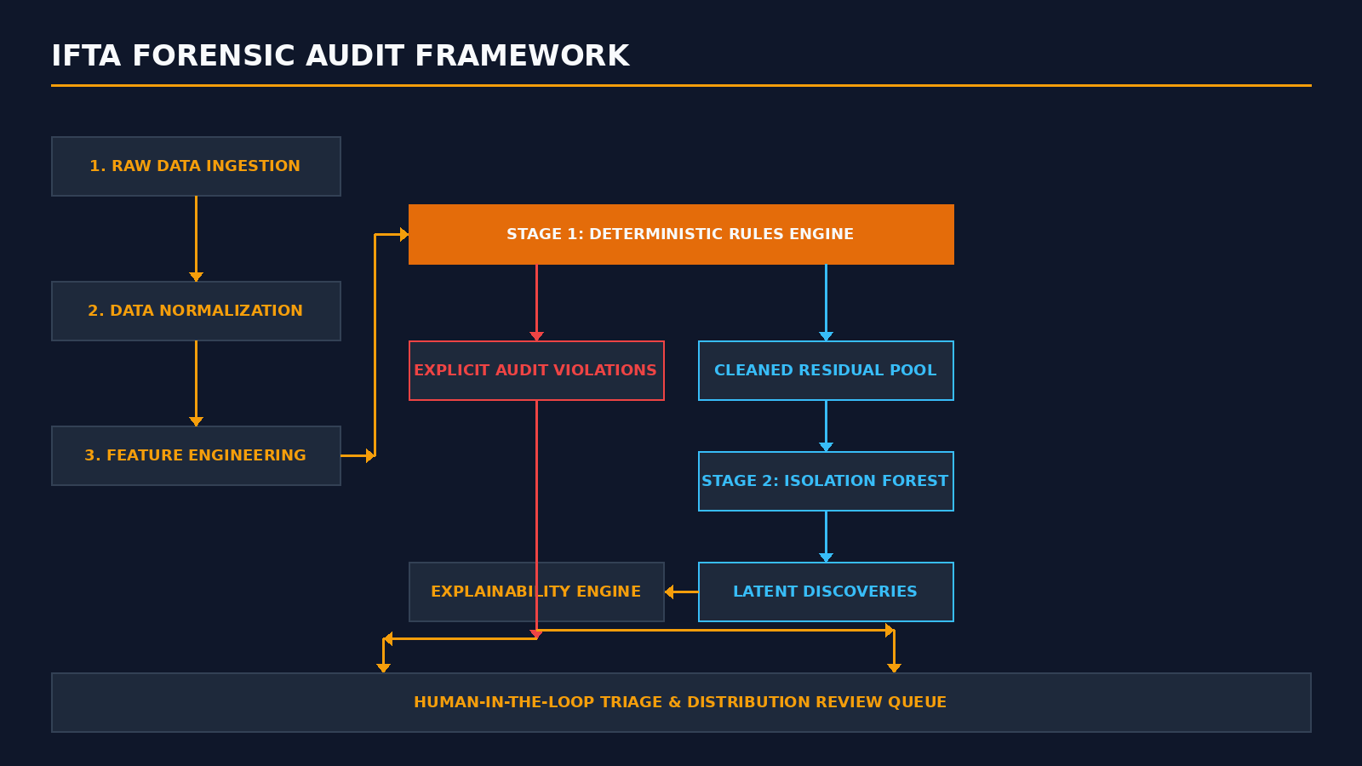
Approach & Methodology

Slide 5
Feature engineering
Total Distance
Total Fuel
Fuel efficiency (L/km)
Cost efficiency (CAD/km)
Jurisdiction-level Distance vs Fuel Proportions
Trip distance averaged over week
Trip distance averaged over month

Slide 6
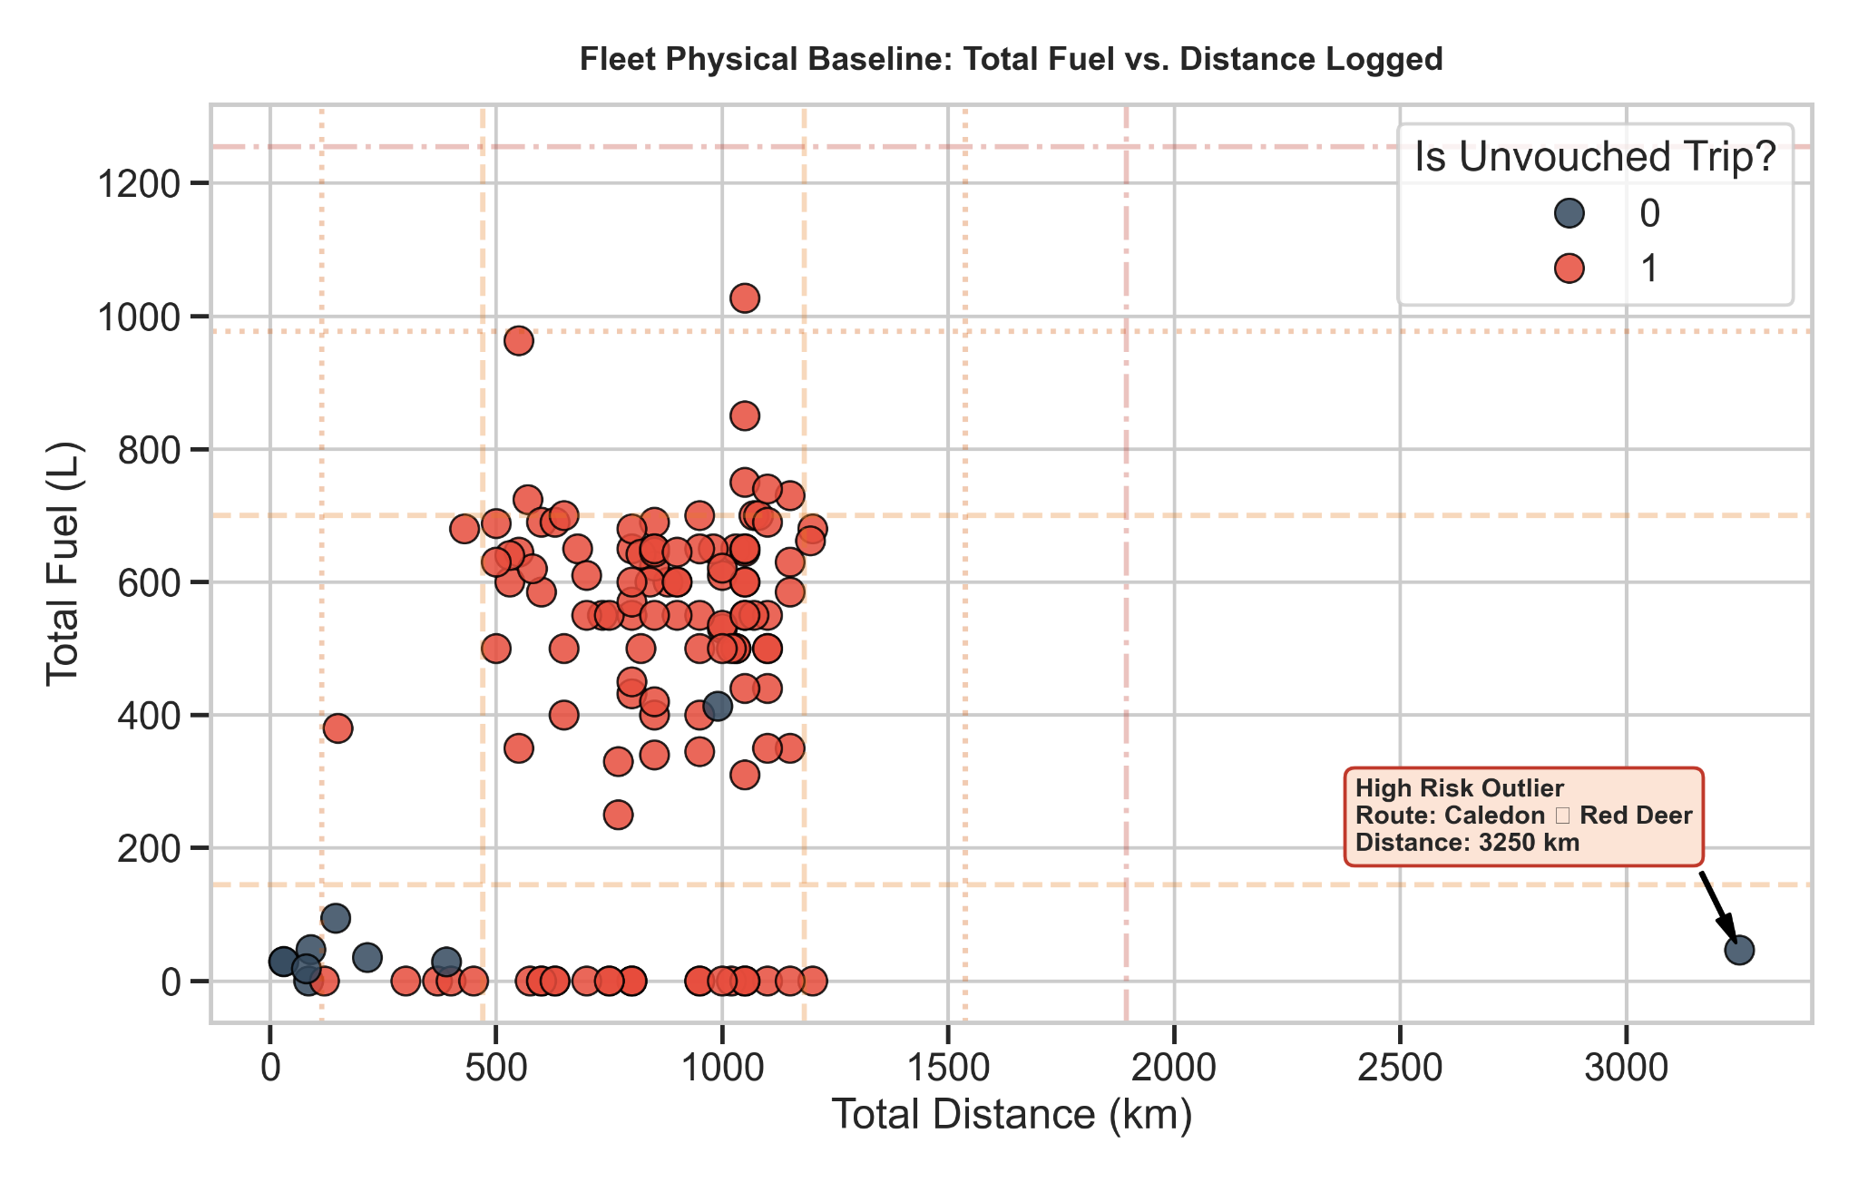
Feature distributions: Total km, L

Slide 7
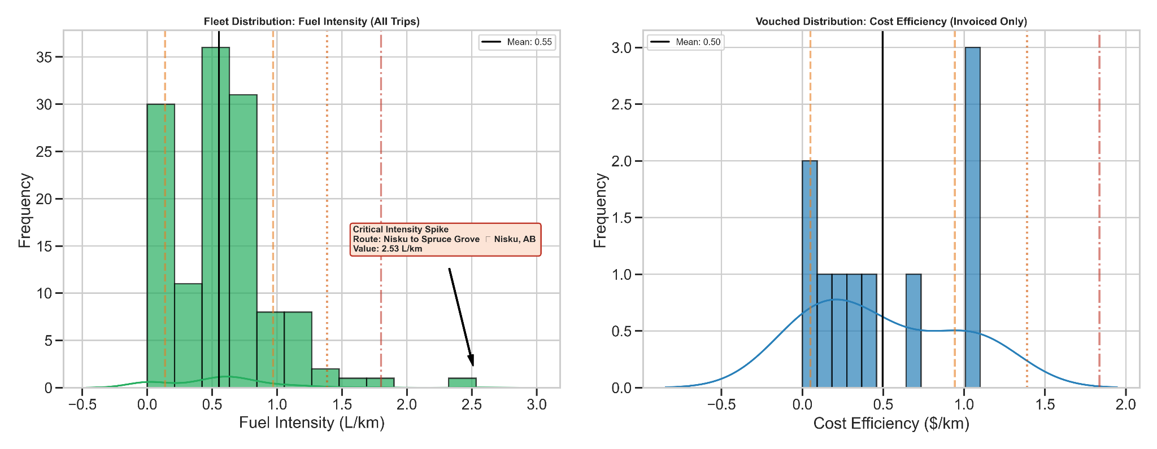
Feature distributions: Efficiency

Slide 8
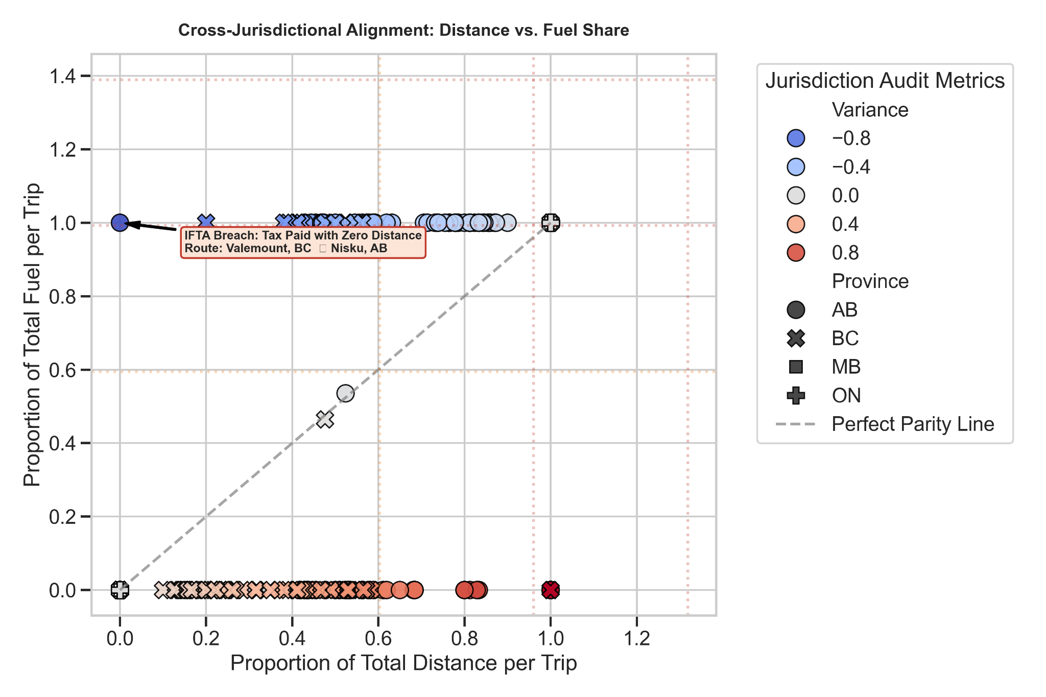
Feature distributions: Proportions

Slide 9
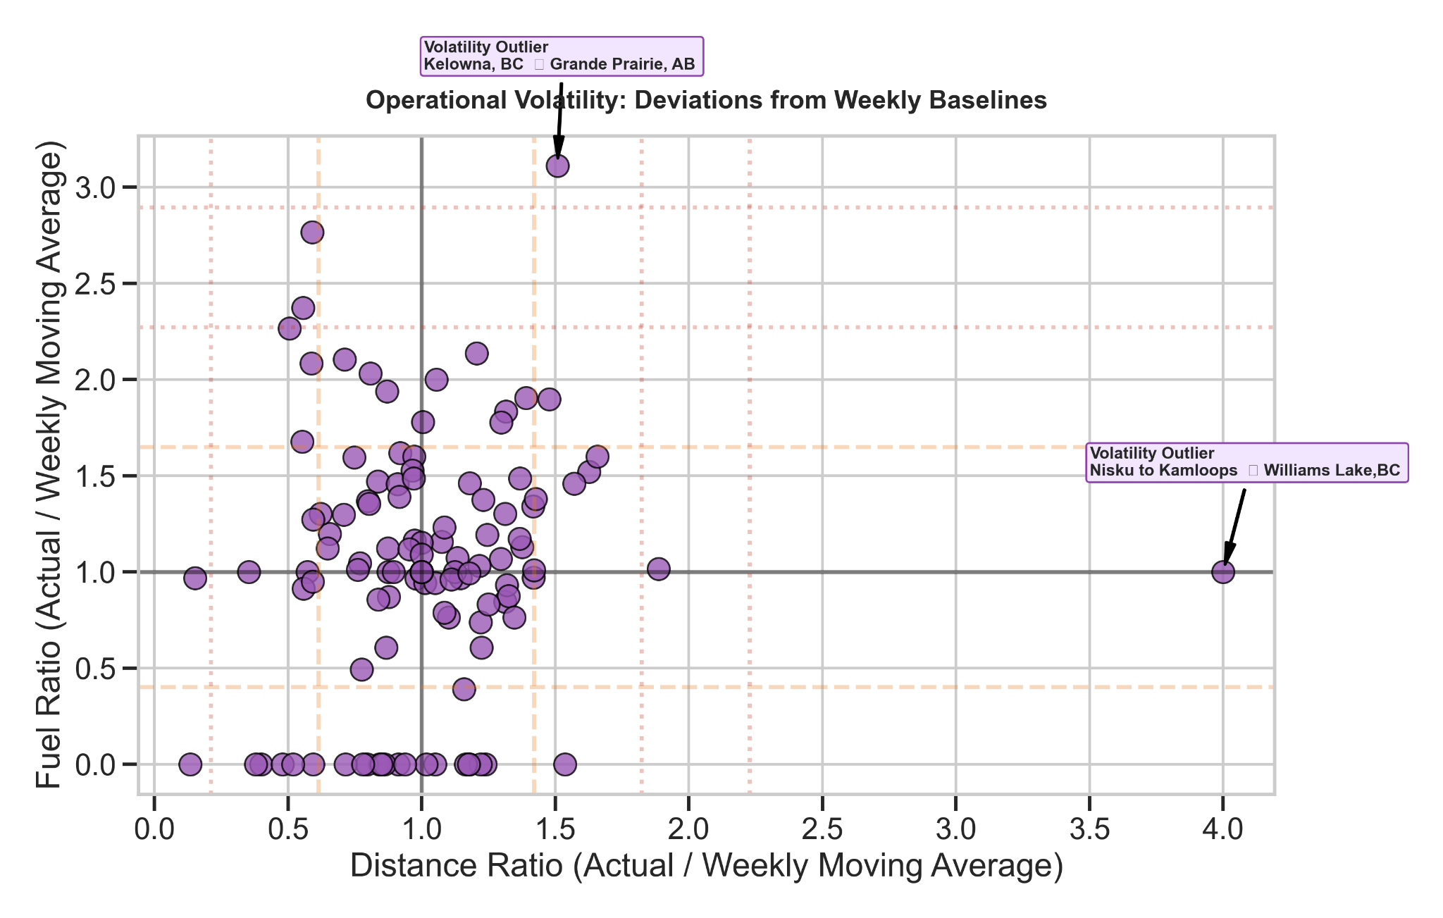
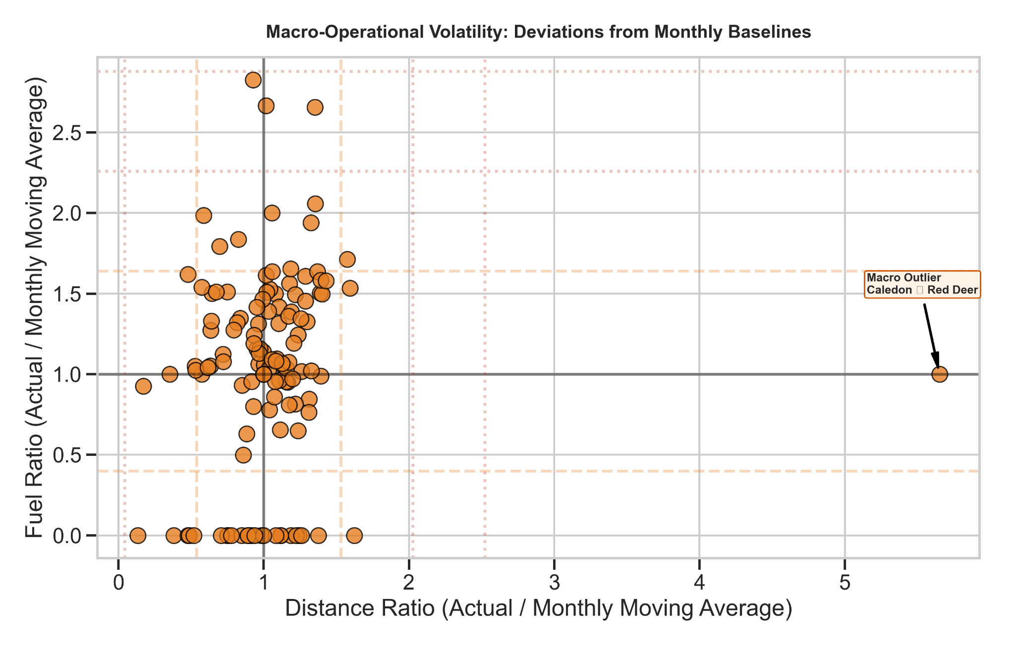
Temporal trends

Slide 10
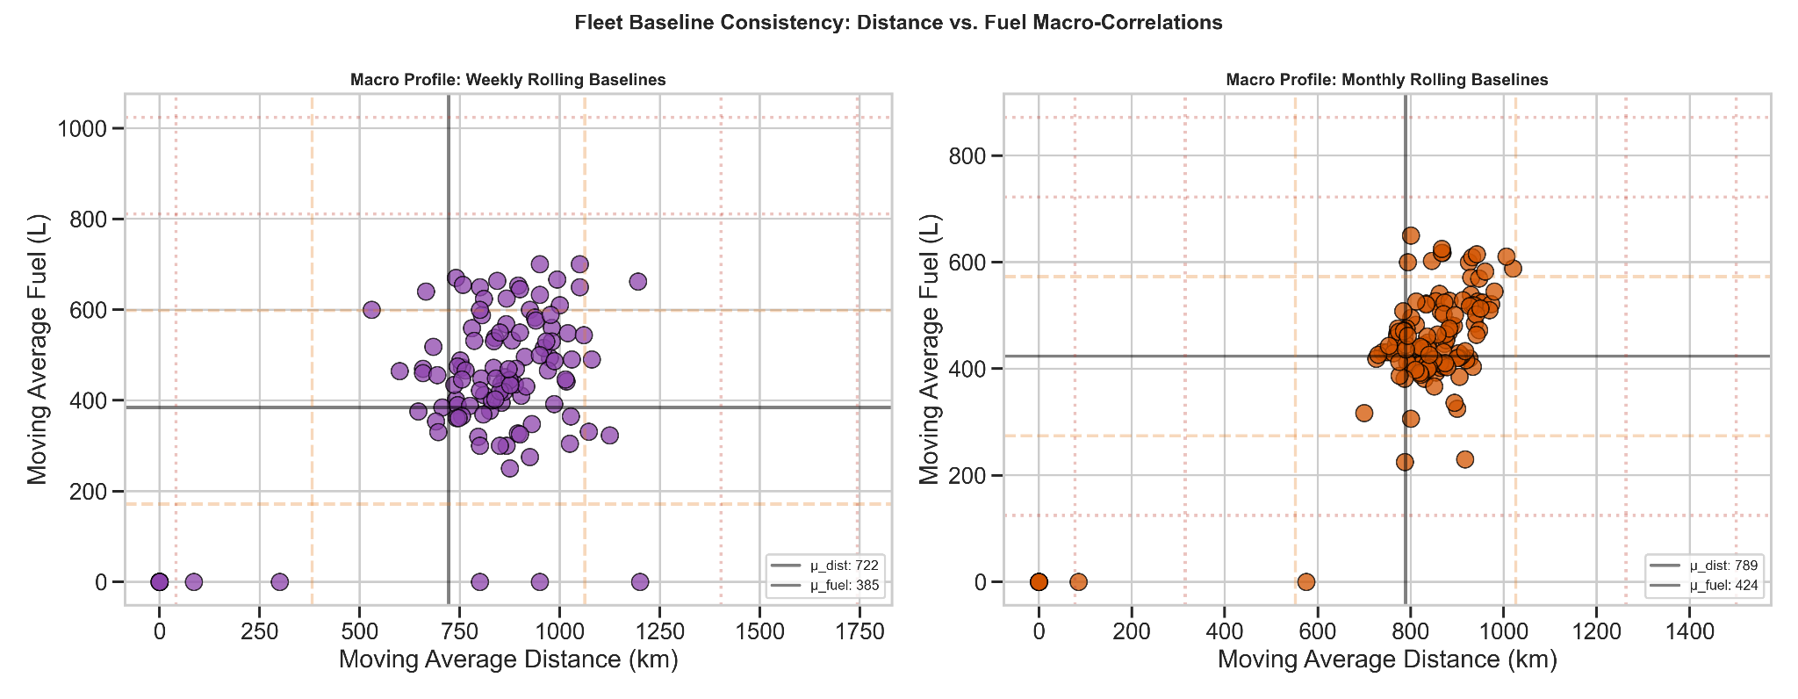
Temporal trends

Slide 11
Anomaly detection
Step 1: Use Heuristic approach through featured data
Shown previously. Remove those data-points for a clean dataframe
Step 2: ML analysis:
Isolated Forests

Slide 12
Overview
Test ML on AGN and Stars
Learn properties of the sources correctly and incorrectly identified
Tailored X-ray colors to identify candidate MSP in Galactic Bulge
Semi-supervised classification of 4XMM-DR14

Slide 13
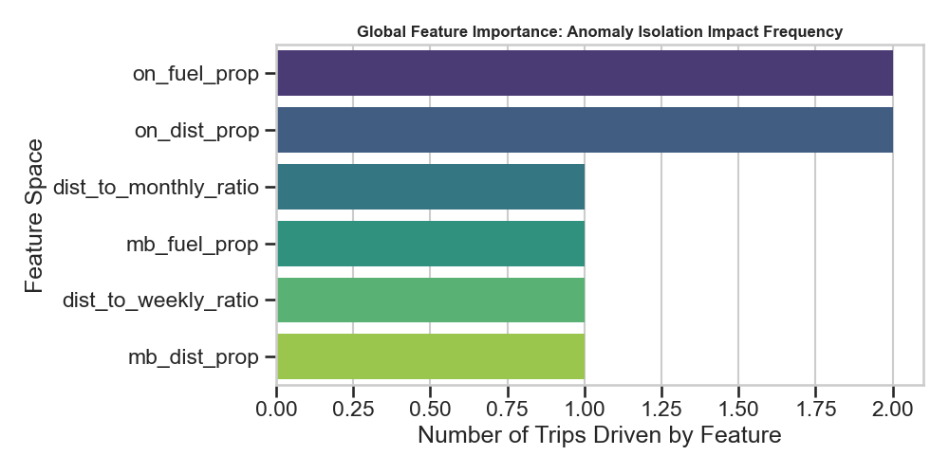
ML analysis: Driving features

Slide 14
Final List of Anomalies
trip_date | trip_origin | trip_destination | Primary Driver
3/16/2016 | Caledon | Red Deer | Rule-Based Violation
1/6/2022 | Valemount, BC | Nisku, AB | Rule-Based Violation
2/13/2022 | Nisku to Kamloops | Williams Lake,BC | Rule-Based Violation
6/6/2022 | Nisku to Spruce Grove | Nisku, AB | Rule-Based Violation
7/2/2022 | Kelowna, BC | Grande Prairie, AB | Rule-Based Violation
5/4/2016 | Langley | Burnaby | dist_to_monthly_ratio
5/8/2021 | Barrie, ON | Willowdale, ON | on_fuel_prop
6/21/2023 | Willowdale | Caledon | on_fuel_prop
11/30/2025 | Winnipeg | Brandon | mb_fuel_prop

Slide 15
Conclusion
Standardizing IFTA logs using OCR extraction simplifies manual data entry
Feature engineering total distance/fuel, fuel efficiencies and proportion by jurisdiction allows for easy identification of anomalies
5 anomalies were detected based on rule-based search
Isolated forests can allow us to look at multiple features simultaneously to identify anomalies

Slide 16
Thank You

Slide 17
Conclusion
Standardizing IFTA logs using OCR extraction simplifies manual data entry
Feature engineering total distance/fuel, fuel efficiencies and proportion by jurisdiction allows for easy identification of anomalies
5 anomalies were detected based on rule-based search
Isolated forests can allow us to look at multiple features simultaneously to identify anomalies

